Slide 1
OBJECTIVE MORAL TRUTHS?

Slide 2
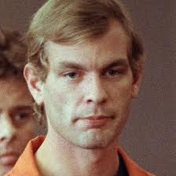
JEFFREY DAHMER

Slide 3
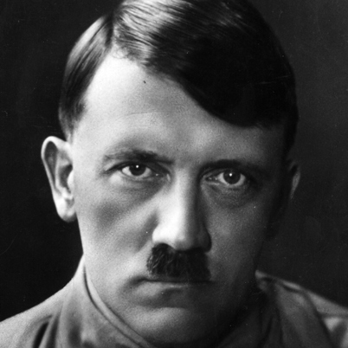
ADOLF HITLER

Slide 4
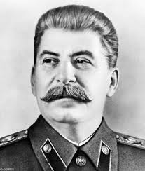
JOSEF STALIN

Slide 5
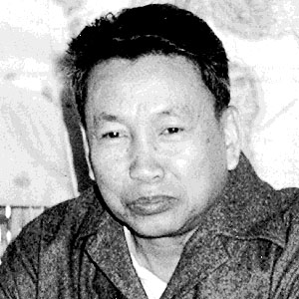
POL POT

Slide 6
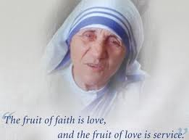
MOTHER TERESA

Slide 7
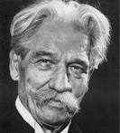
ALBERT SCHWEITZER

Slide 8
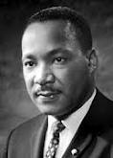
MARTIN LUTHER KING

Slide 9
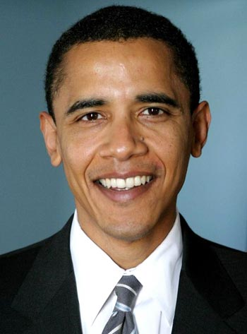
PRESIDENT BARACK OBAMA

Slide 10
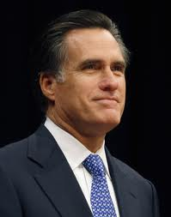
GOVENOR MITT ROMNEY

Slide 11
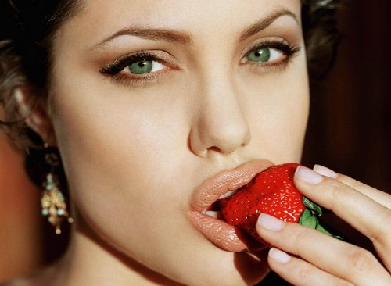
ANGELINA JOLIE

Slide 12
MORAL ARGUMENTS FOR THEISTIC BELIEF
ROBERT MERRIHEW ADAMS

Slide 13
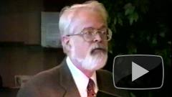
ROBERT M. ADAMS (1937- )

Slide 14
THE ARGUMENT FROM THE NATURE OF RIGHT AND WRONG
THIS AGAIN IS ESSENTIALLY AN ARGUMENT THAT IS MEANT TO BE INDUCTIVELY STRONG.
THE HYPOTHESIS THAT THERE IS A PERFECTLY GOOD BEING IS SUPPOSED TO BE MADE PROBABLE BY ADAMS’S OBSERVATIONS ABOUT MORAL TRUTHS.

Slide 15
AN HYPOTHESIS WHICH IS SUPPOSED TO EXPLAIN CERTAIN “DATA”:
(AH) THERE IS A LOVING GOD WHO IS SUCH THAT RIGHT AND WRONG “CONSIST IN” AGREEMENT OR DISAGREEMENT WITH THE WILL OR COMMANDS OF SUCH A LOVING GOD.

Slide 16
ALLEGED ADVANTAGES TO THE MODIFIED DIVINE COMMAND THEORY
THIS IS AN ATTEMPT BY ADAMS TO SHOW THAT THIS HYPOTHESIS HAS SOME POSITIVE FEATURES AND IS MADE THEREBY MORE PROBABLE AS AN EXPLANATION.
ACCORDING TO AH THE PROPERTY OF RIGHTNESS IS A NON-NATURAL PROPERTY.
ACCORDING TO AH, RIGHTNESS IS AN
OB JECTIVE FEATURE OF ACTIONS.

Slide 17
“WRONG MEANING” OBJECTION
“AGREES WITH THE COMMANDS OF GOD” IS NOT WHAT MOST PEOPLE MEAN BY “RIGHT”.
EVEN ATHEISTS MAY BELIEVE THAT SOME THINGS ARE OBJECTIVELY RIGHT (OR GOOD), BUT THEY DON’T BELIEVE IN GOD. SO THEY CERTAINLY DON’T MEAN THIS BY “RIGHT” (SIMILARLY FOR “WRONG”).

Slide 18
ADAMS’ REPLY TO THIS OBJECTION
THE ‘MODIFIED DIVINE COMMAND THEORY ‘
DOES NOT CLAIM THAT ‘RIGHT’ (AS APPLIED TO
ACTIONS) MEANS THE SAME AS ‘COMMANDED
(OR WILLED) BY A LOVING GOD.’
RATHER, THE HYPOTHESIS (AH) IS THAT THE
TERM ‘RIGHT’ STANDS FOR THE PROPERTY OF
BEING COMMANDED (OR WILLED) BY A
LOVING GOD.

Slide 19
EXPLANATION: ADAMS IS HERE APPEALING TO
SOME NEW IDEAS IN THE PHILOSOPHY OF
LANGUAGE (!).
SAUL KRIPKE HAS ARGUED THAT GENERAL
TERMS, E.G. ‘HEAT’ , STAND FOR CERTAIN
PROPERTIES , BUT THEY DON’T MEAN OR
CONVEY EVERYTHING THAT IS TRUE OF THE
PROPERTY. IN THE CASE OF ‘HEAT’ , THE PROPERTY
THAT IT STANDS FOR IS: HAVING ITS MOLECULES
IN MOTION. WHAT IT MEANS IS SOMETHING
ELSE.

Slide 20
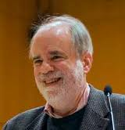
SAUL KRIPKE (1940 - )

Slide 21
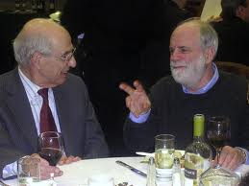
HILARY PUTNAM AND SAUL KRIPKE

Slide 22
ADAMS’ THEORY OR HYPOTHESIS (AH) IS
THAT THE TERM ‘RIGHT’ STANDS FOR THE
PROPERTY OF BEING COMMANDED BY A
LOVING GOD.
IT MEANS SOMETHING THAT IS COMMON
TO ATHEISTS AND THEISTS (AND AGNOSTICS)
WHEN THEY SPEAK OF CERTAIN ACTIONS AS
BEING MORALLY RIGHT .

Slide 23
THE ‘EUTHYPHRO OBJECTION’
(1) IF THE RIGHTNESS OF AN ACTION DEPENDS ON THE COMMANDS OF A LOVING GOD, THEN HE COULD HAVE COMMANDED THAT WE BE CRUEL TO OUR NEIGHBORS.
(2) IF GOD HAD COMMANDED THAT WE BE CRUEL TO OUR NEIGHBORS, THEN (ACCORDING TO AH) IT WOULD HAVE BEEN RIGHT TO BE CRUEL TO OUR NEIGHBORS.

Slide 24
BUT:
IT COULD NOT HAVE BEEN RIGHT TO BE CRUEL TO OUR NEIGHBORS.
THEREFORE:
(4) THE RIGHTNESS OF AN ACTION CANNOT DEPEND ON THE WILL OF GOD – HENCE AH IS FALSE.

Slide 25
ADAMS’ REPLY TO THE EUTHYPHRO OBJECTION
ADAMS’ REPLY TO THIS OBJECTION IS RATHER
COMPLICATED.
A GOD WHO COMMANDED CRUELTY WOULD NOT BE A LOVING GOD. THE MODIFIED DIVINE COMMAND THEORY (AH) DOES NOT IMPLY THAT IT WOULD BE WRONG TO DISOBEY SUCH A COMMAND.
THIS, I BELIEVE, IS SUPPOSED TO BE A REJECTION OF PREMISE (2). IT TAKES A BIT OF CAREFUL THINKING TO SEE THIS, BUT ADAMS IS CORRECT ABOUT THIS POINT.

Slide 26
A DIFFERENT REPLY TO THE EUTHYPHRO OBJECTION
IF IT IS MAINTAINED (BY THE THEIST) THAT GOD IS NECESSARILY ALL-GOOD – AND NOT JUST (CONTINGENTLY) ALL-GOOD, THEN HE MAY REPLY THAT PREMISE (1) IS FALSE. ON THIS HYPOTHESIS, GOD COULD NOT HAVE COMMANDED THAT WE BE CRUEL TO OUR NEIGHBORS. (THIS ASSUMES THAT THE THEIST AGREES THAT CRUELTY COULD NOT HAVE BEEN A RIGHT KIND OF ACTION.)

Slide 27
SUCH A THEIST NEED NOT REJECT ADAMS’ MODIFIED DIVINE COMMAND THEORY (AH),
BUT THERE WOULD BE LITTLE MOTIVATION FOR HIM (OR HER) TO COMPLICATE THE DIVINE COMMAND THEORY IN THIS WAY. TO REBUT THE “WRONG MEANING OBJECTION”, THE THEIST WOULD STILL NEED TO AVOID CLAIMING THAT HE (OR SHE) IS OFFERING A DEFINITION OF RIGHT (AND WRONG),

